Slide 1


Hack the Box: Remote
Daniel Herold

Slide 2
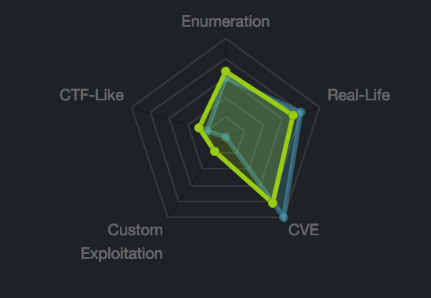
Overview
Windows Box
Medium Difficulty
EU Dedicated 30

Slide 3
Tools Used
Cat
Curl
Echo
Gobuster
Grep
Kali Linux
Mount
NetCat
PowerUp.ps1
Python
Python Http Server
Reverse PowerShell
Showmount
Strings
Umbraco RCE Exploit

Slide 4
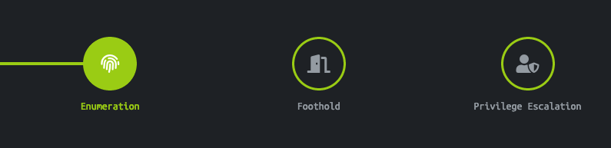
Enumeration

Slide 5
NMAP

Slide 6
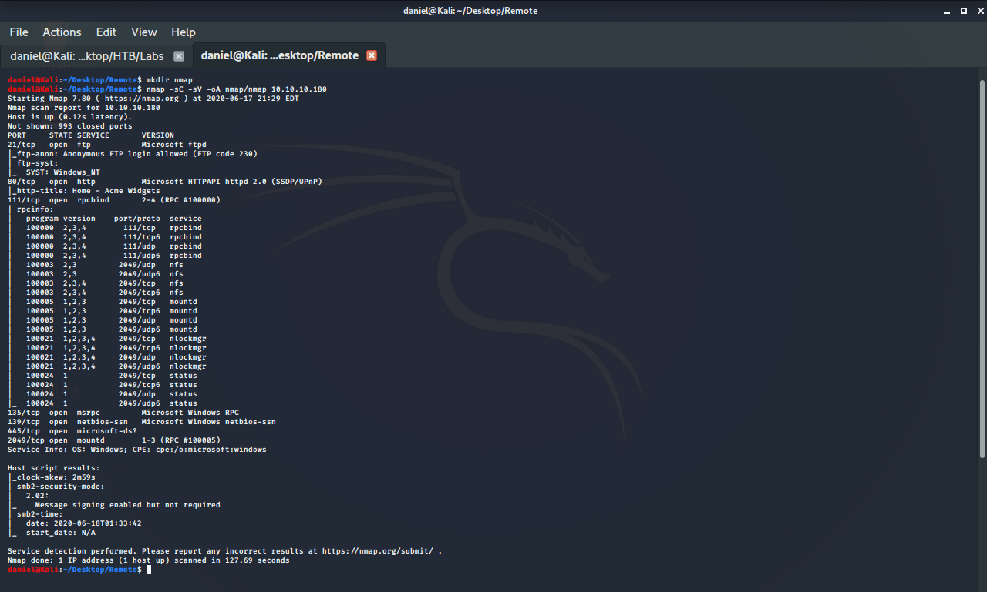

Slide 7
NMAP
Enumerates Open Ports on a Machine
Flags:
Runs most common scripts: -sC
Shows service version: -sV
Writes to file: -oA

Slide 8
FTP

Slide 9
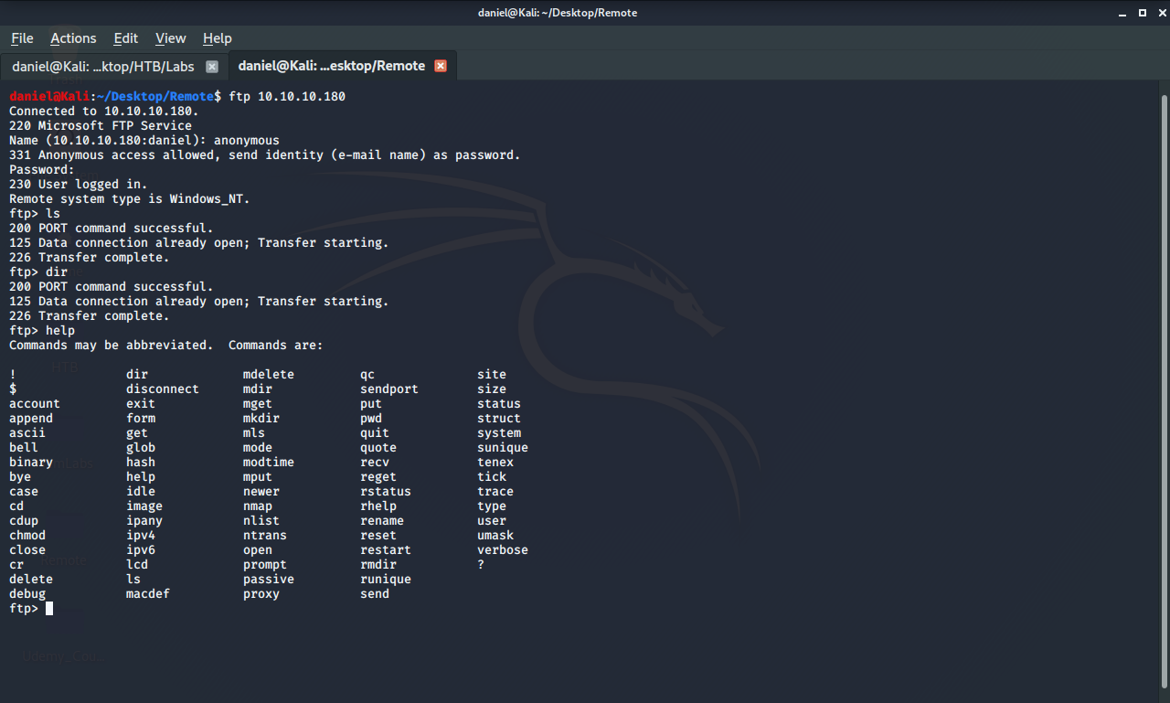

Slide 10
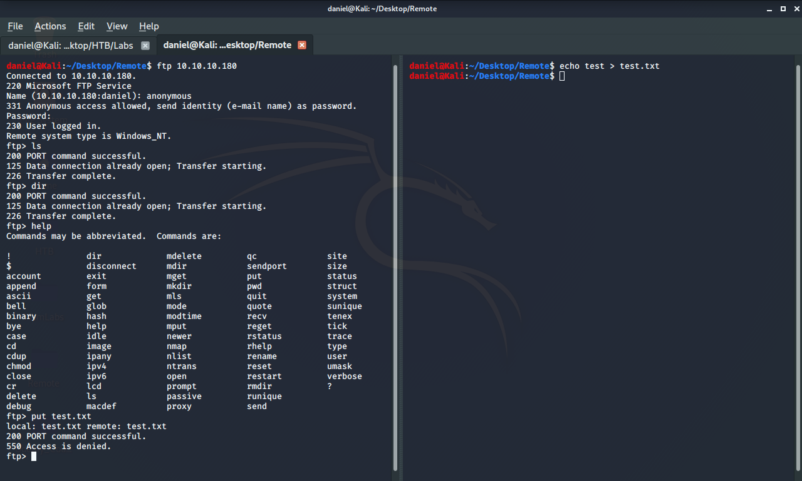

Slide 11
FTP
FTP - File Transfer Protocol
Checking anonymous login
Attempting to upload test file

Slide 12
HTTP

Slide 13
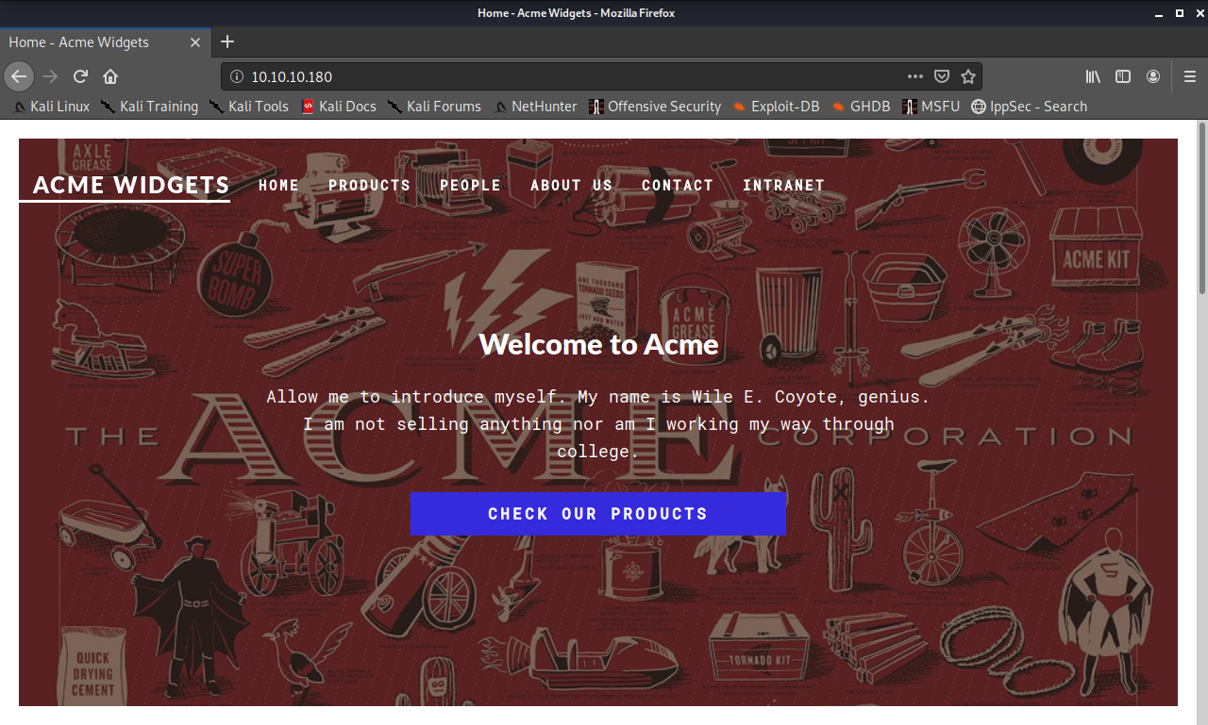

Slide 14
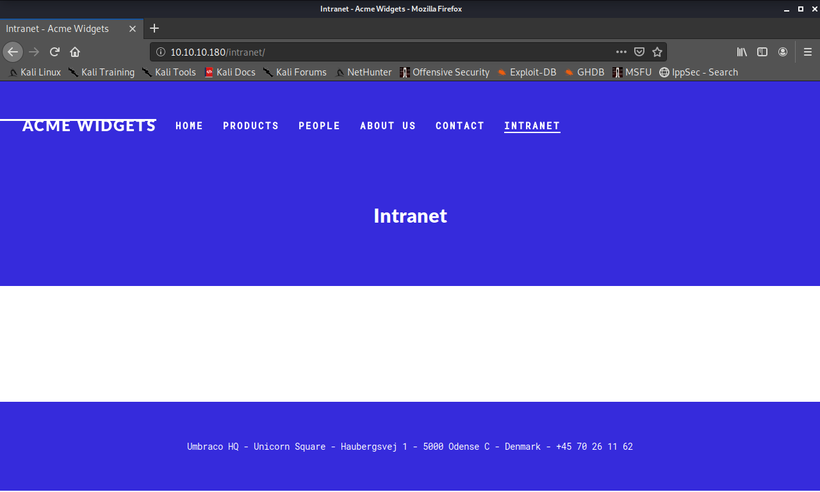

Slide 15
HTTP
Large attack surface
File upload pages
Hidden directories
Login pages

Slide 16
Dirbuster

Slide 17
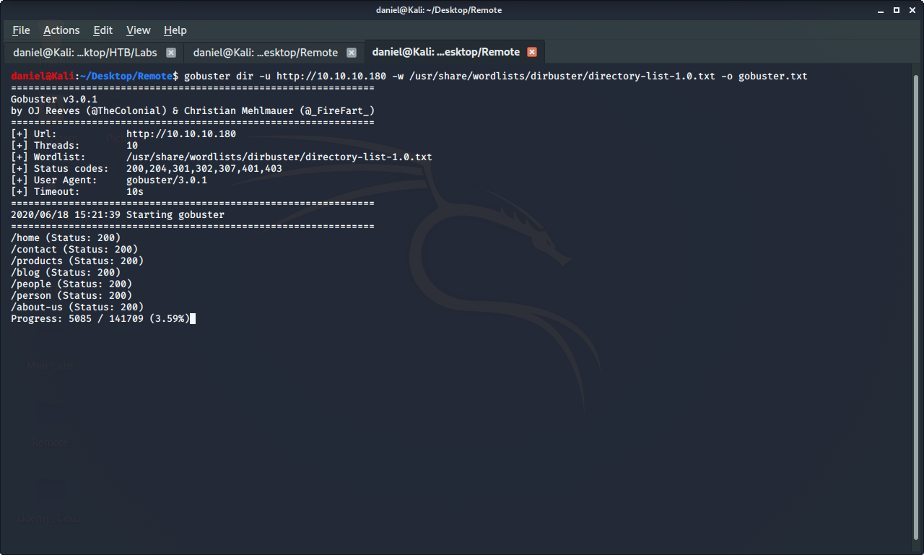

Slide 18
Gobuster
Command line version of dirbuster
Flags:
Busting directory: dir
URL: -u
Wordlist: -w <common directory list>
Outfile: -o

Slide 19
SMB

Slide 20
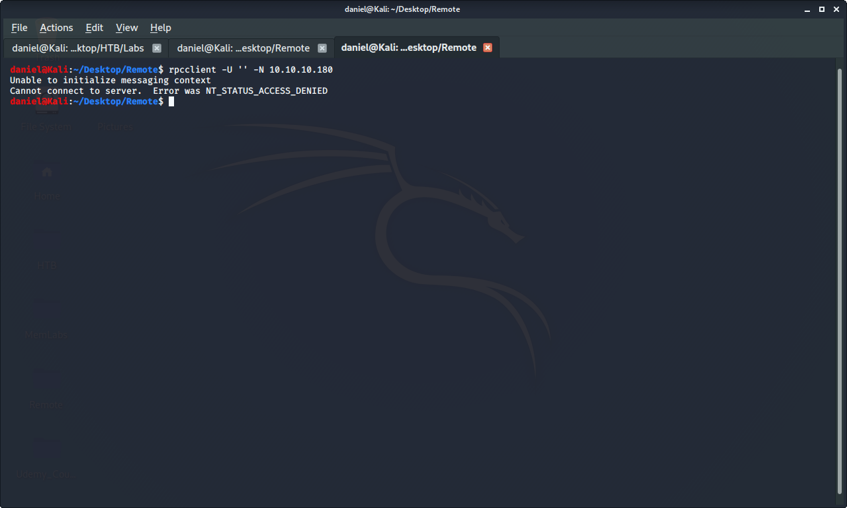

Slide 21
SMB Login
SMB: Server Message Block
Communicates using RPC: Remote Procedure Call
Anonymous login
Enumerate Users
Access Files

Slide 22
NFS Share

Slide 23
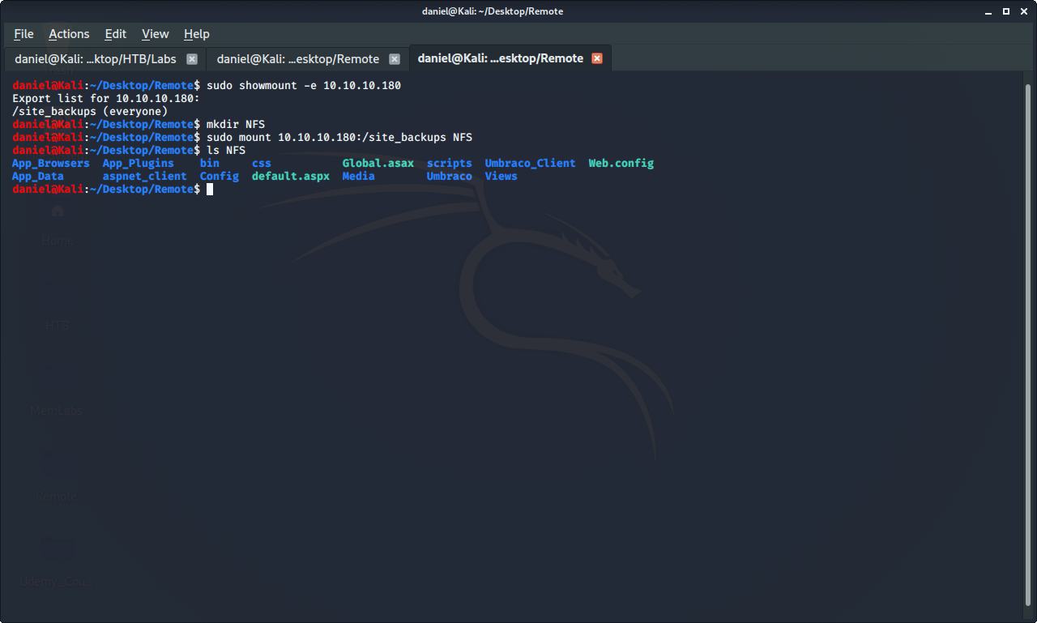

Slide 24
NFS Share
NFS: Network File System
No password
Flag:
Show Exports: -e

Slide 25
Dirbuster

Slide 26
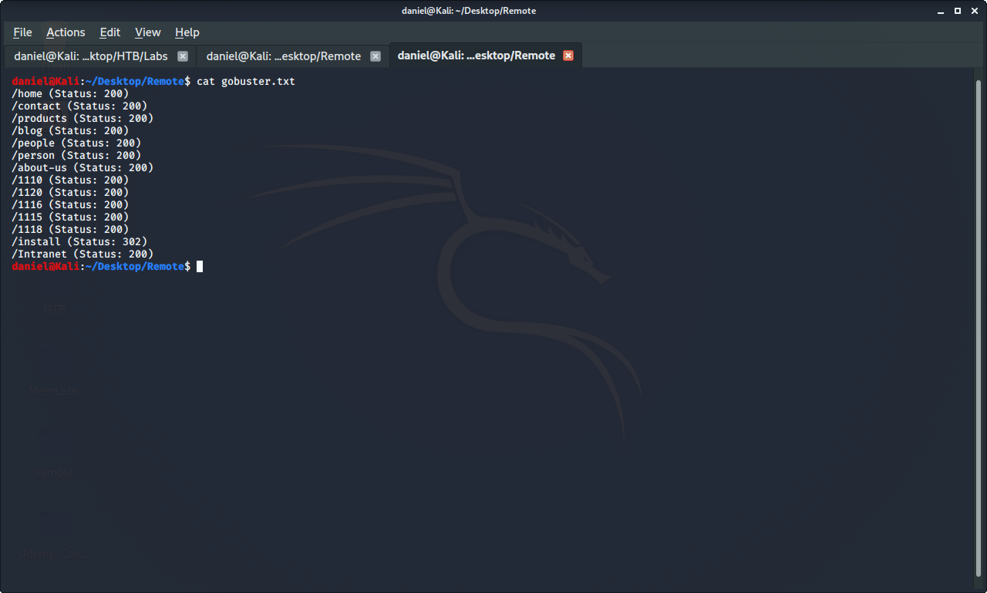

Slide 27
Umbraco

Slide 28
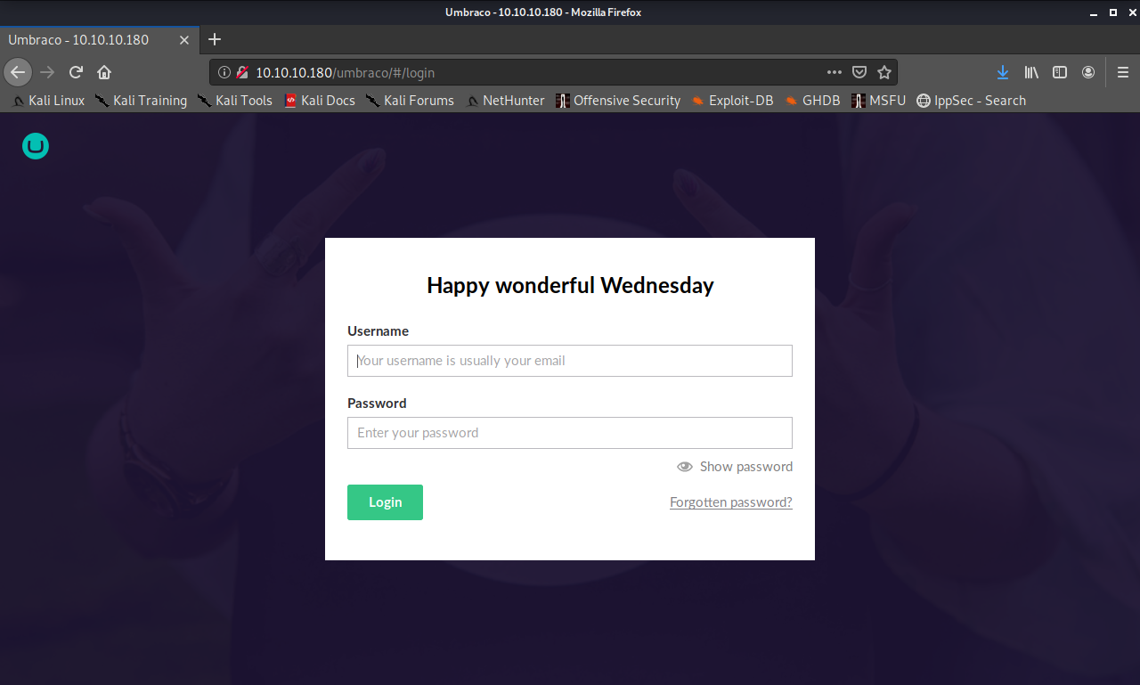

Slide 29
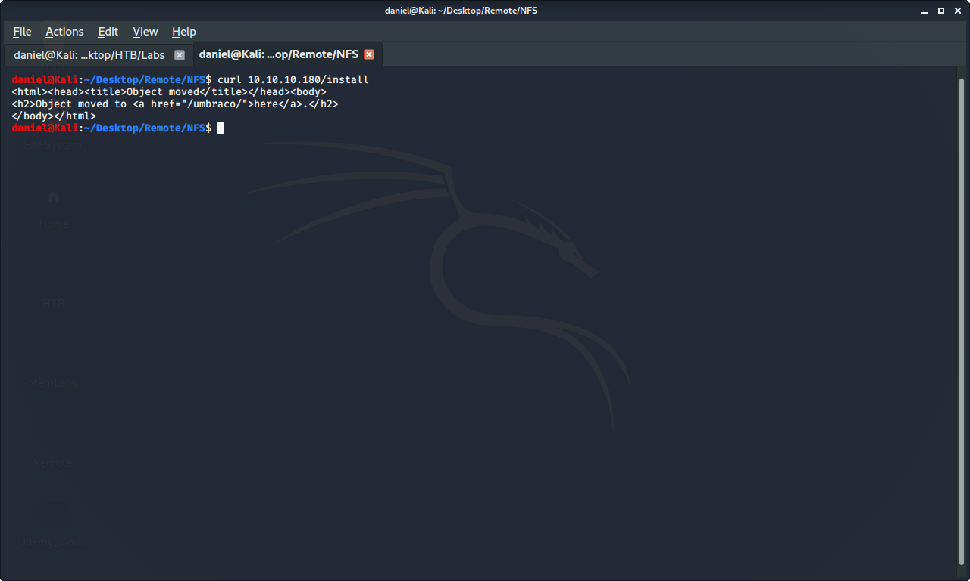

Slide 30
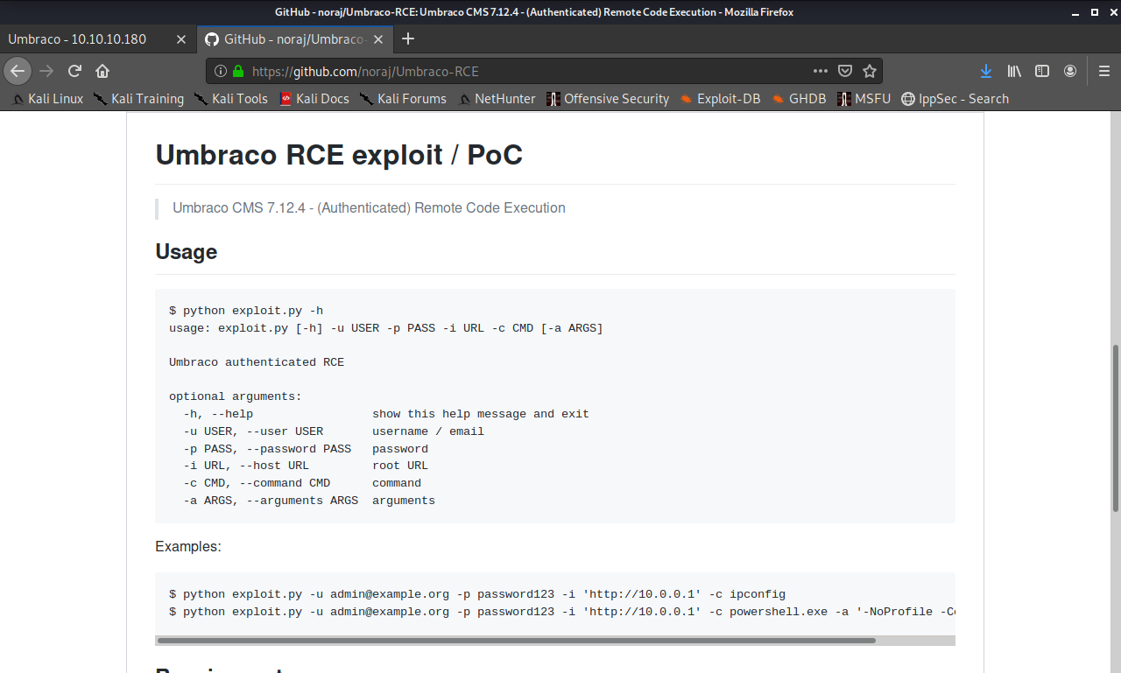

Slide 31
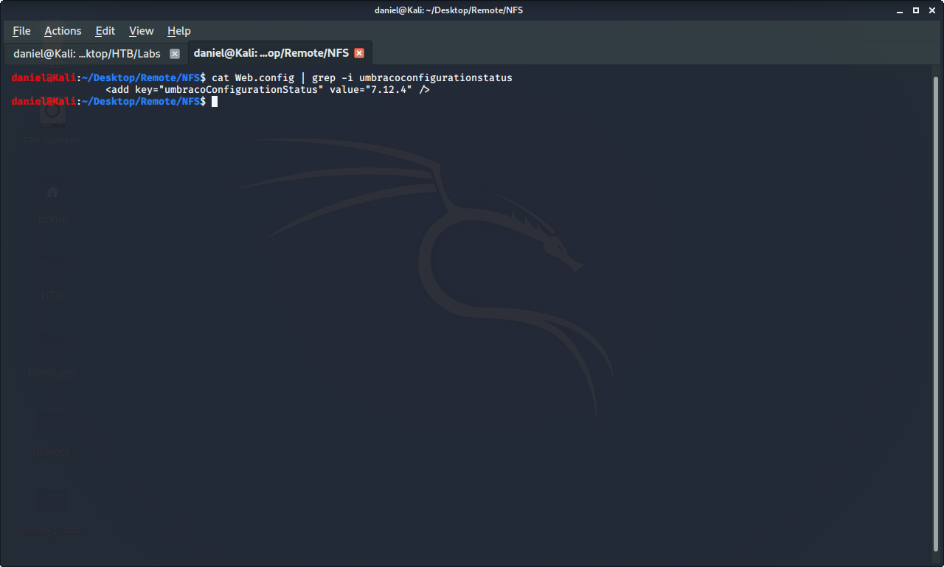

Slide 32
Umbraco
Content management system platform
Remote code execution vulnerability on this version
Page redirects from /install/ to /umbraco/

Slide 33
Umbraco Passwords

Slide 34
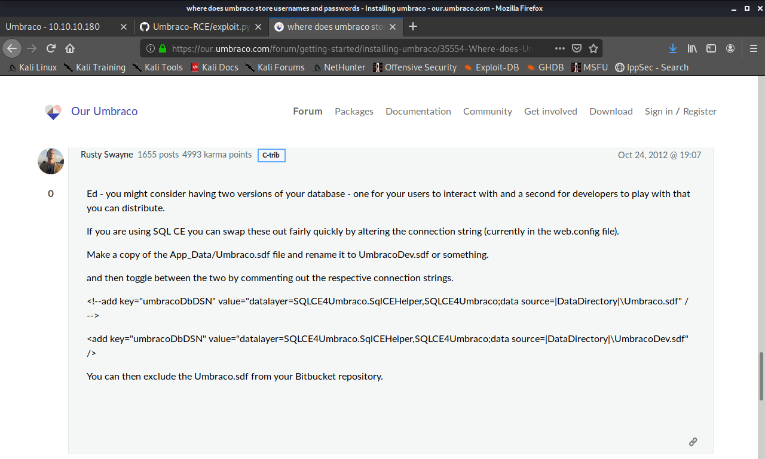

Slide 35
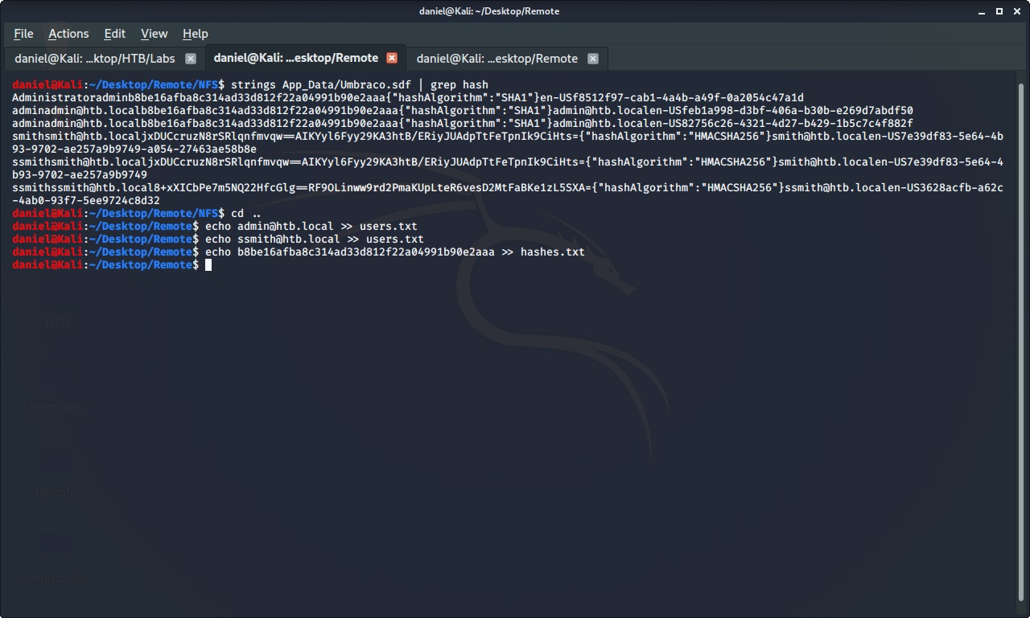

Slide 36
Umbraco Passwords
Stored in .sdf database file
Strings is used to print text strings that are found in binary files
Hashed with SHA1 algorithm

Slide 37
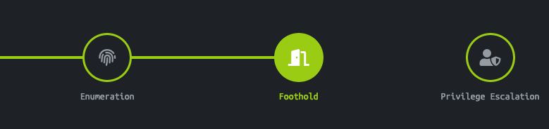
Foothold

Slide 38
John The Ripper

Slide 39
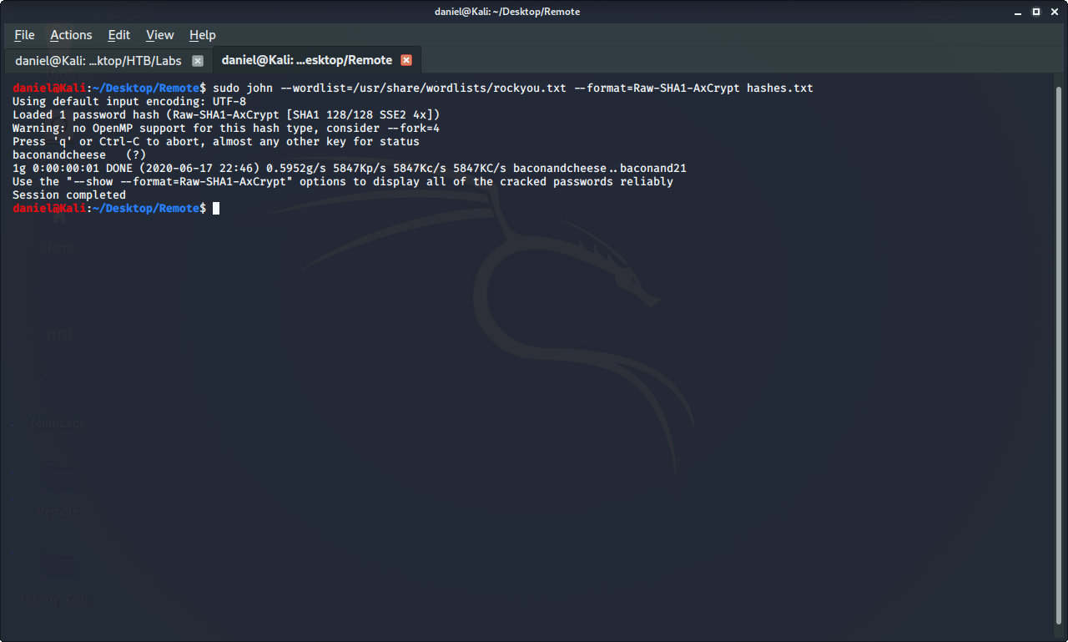

Slide 40
Cracking Hashes
John The Ripper is used to crack passwords
RockYou wordlist - massive wordlist of the most common passwords
Raw SHA1 Format - suggested by John The Ripper
Hashes.txt - where the hash is stored

Slide 41
Umbraco Exploit

Slide 42
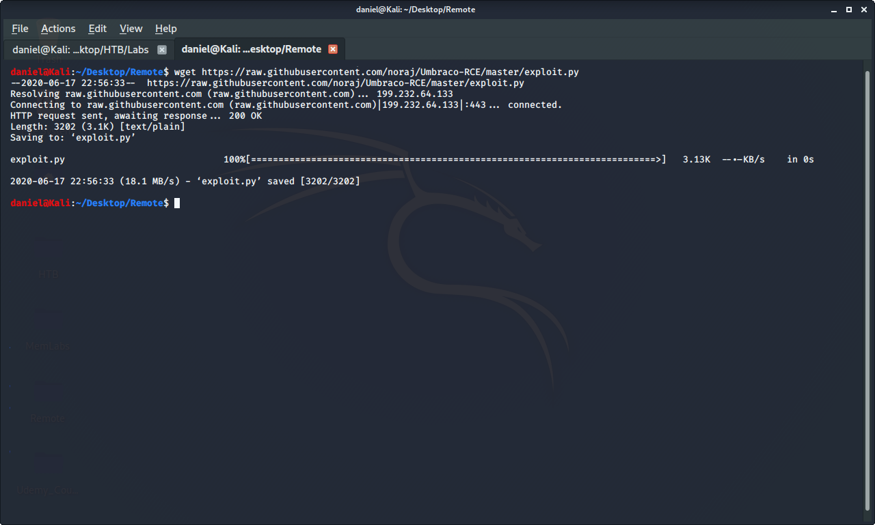

Slide 43
HTTP Server

Slide 44
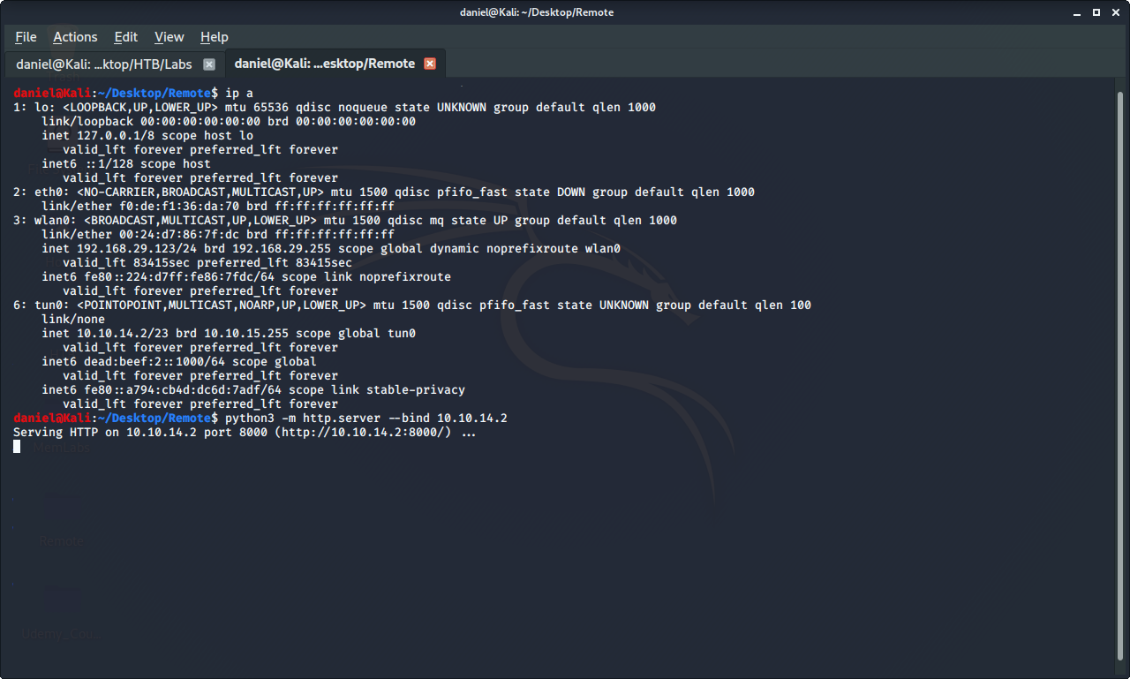

Slide 45
Python HTTP Server
Python has built-in webserver
Runs over port 8000 by default
Binds to Machine’s ip address
Used to download files remotely
Flag:
Run library module as script: -m

Slide 46
Umbraco Exploit

Slide 47
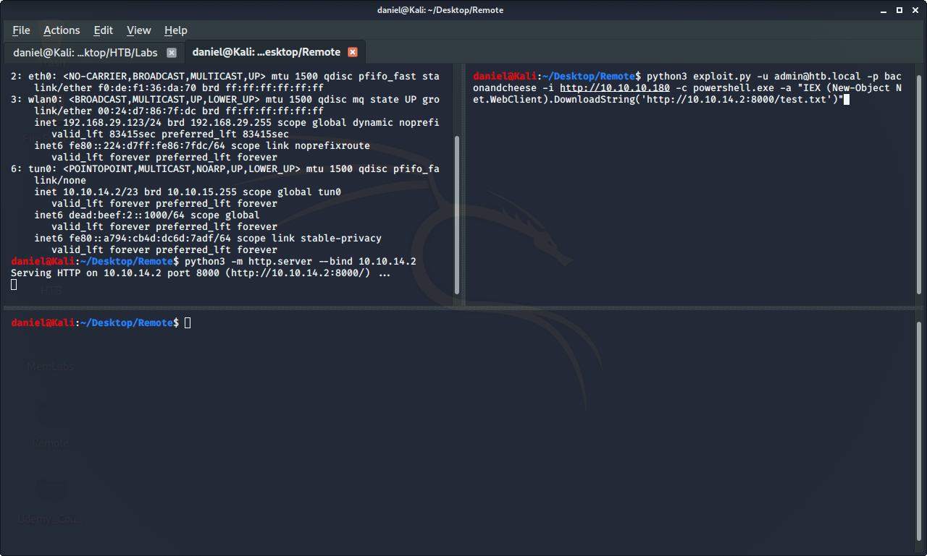

Slide 48
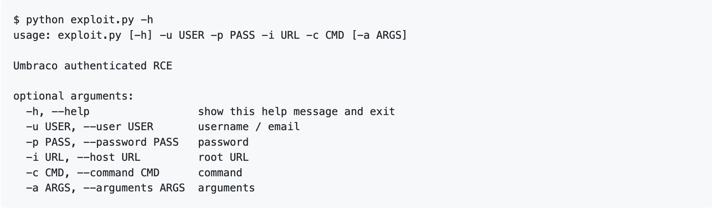
Umbraco Exploit (From Github)

Slide 49
Testing HTTP Server

Slide 50
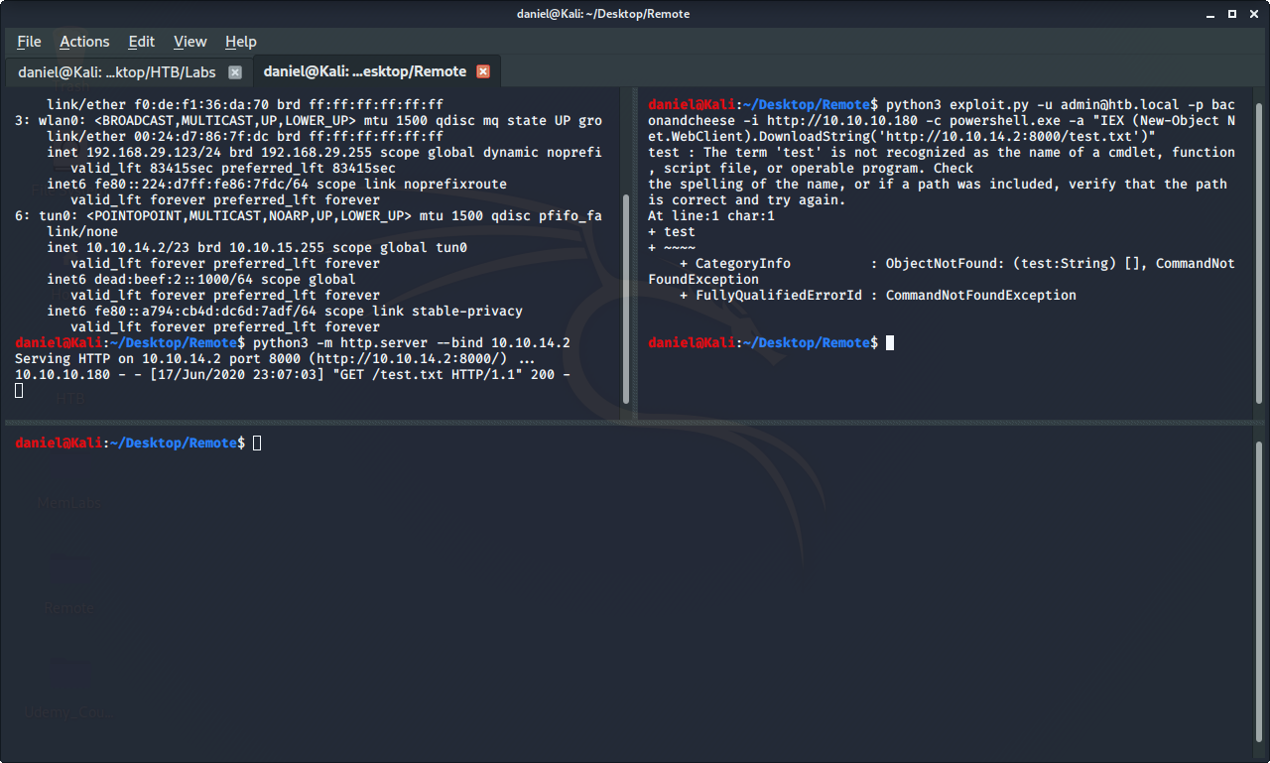

Slide 51
Reverse Shell

Slide 52
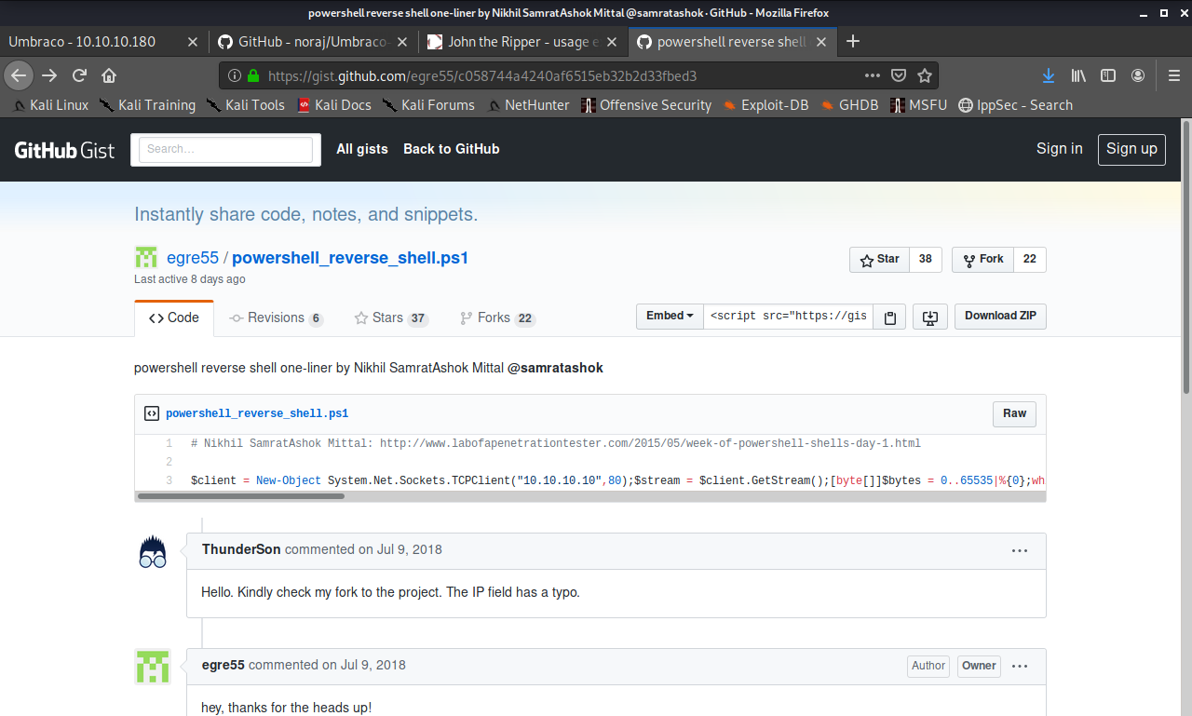

Slide 53
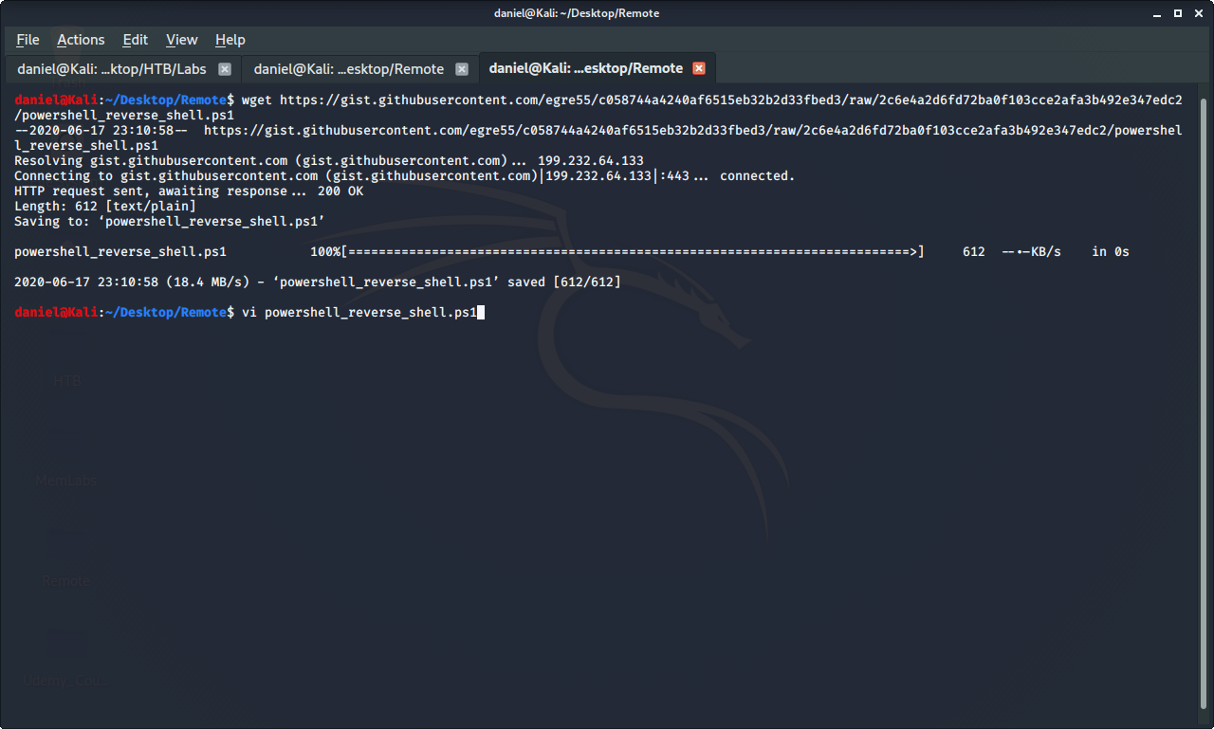

Slide 54
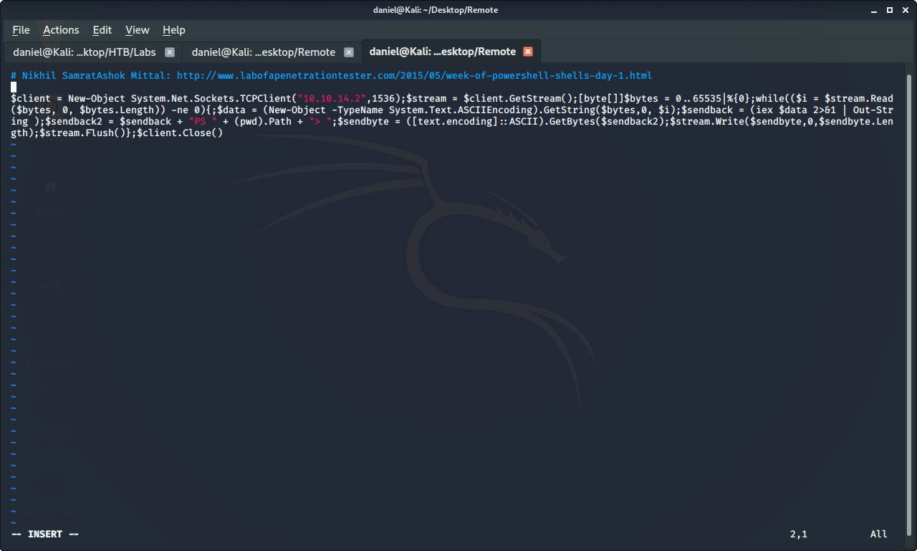

Slide 55
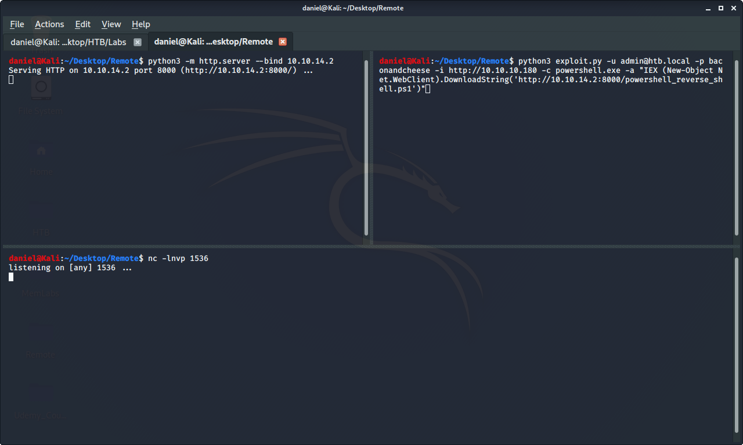

Slide 56
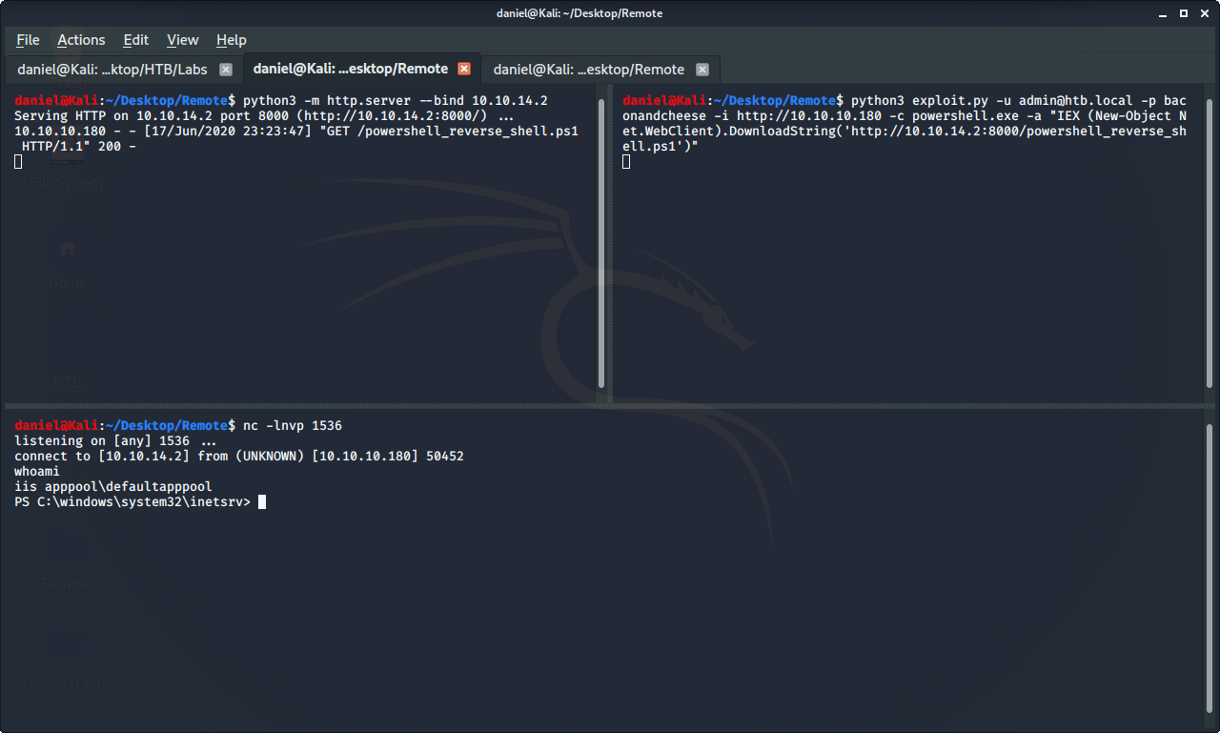

Slide 57
User Flag

Slide 58
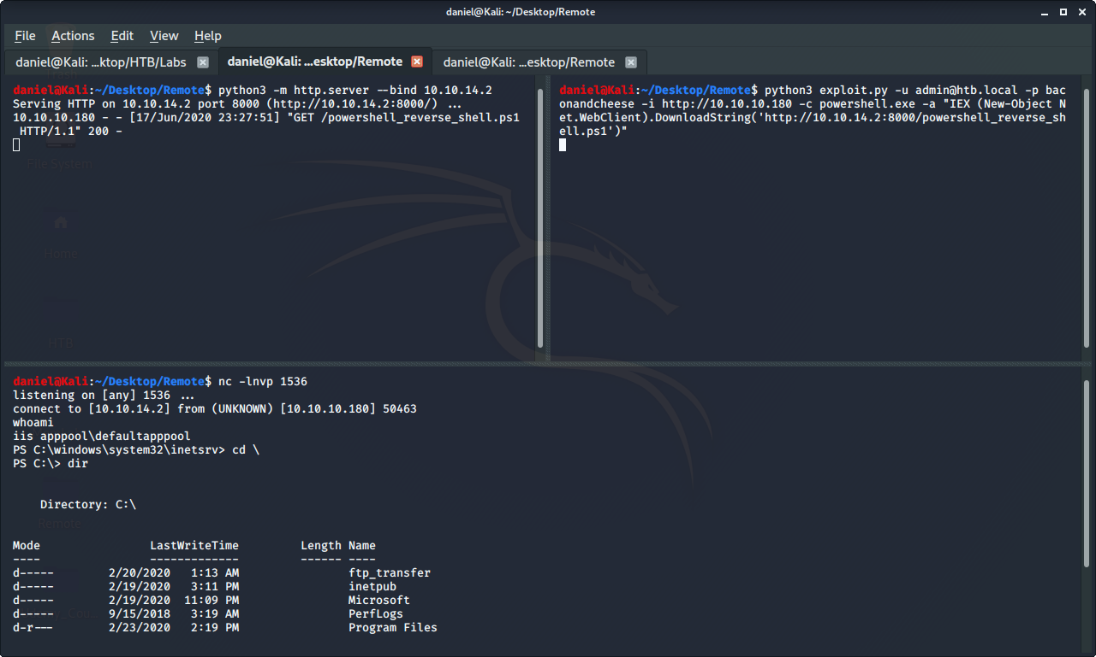

Slide 59
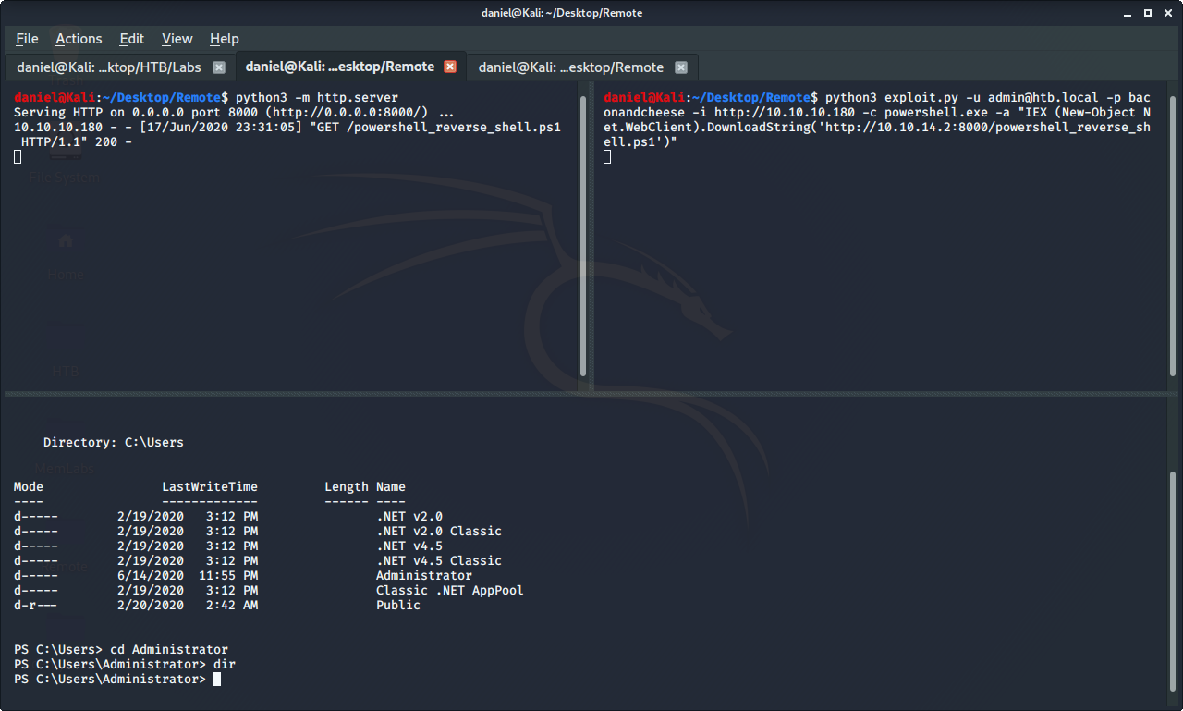

Slide 60
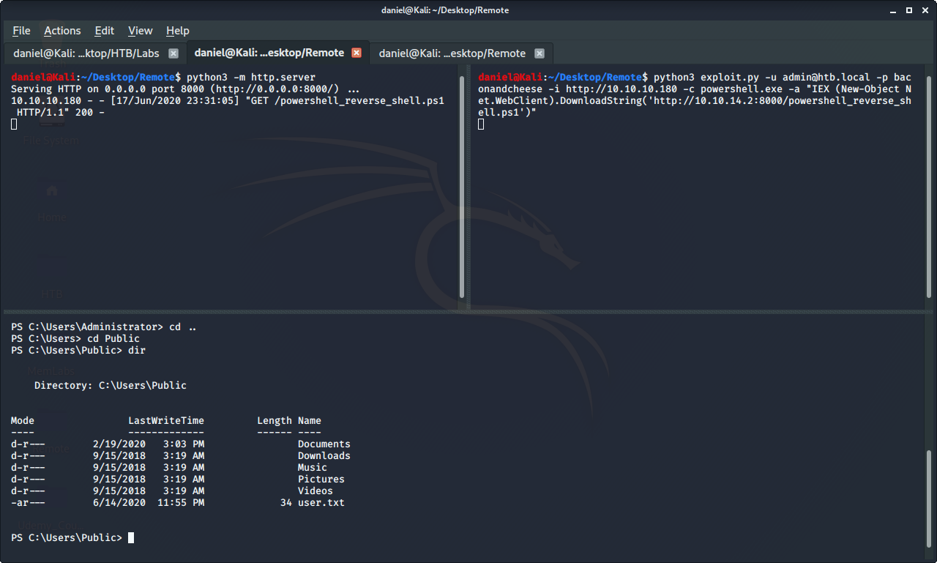

Slide 61
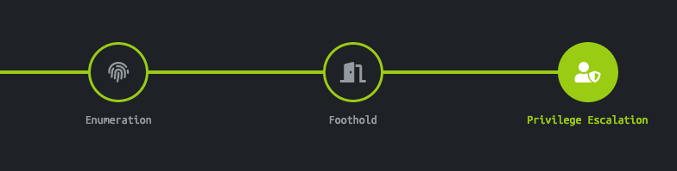
Privilege Escalation

Slide 62


Two Retired Boxes That Helped

Slide 63
PowerUp Tool

Slide 64
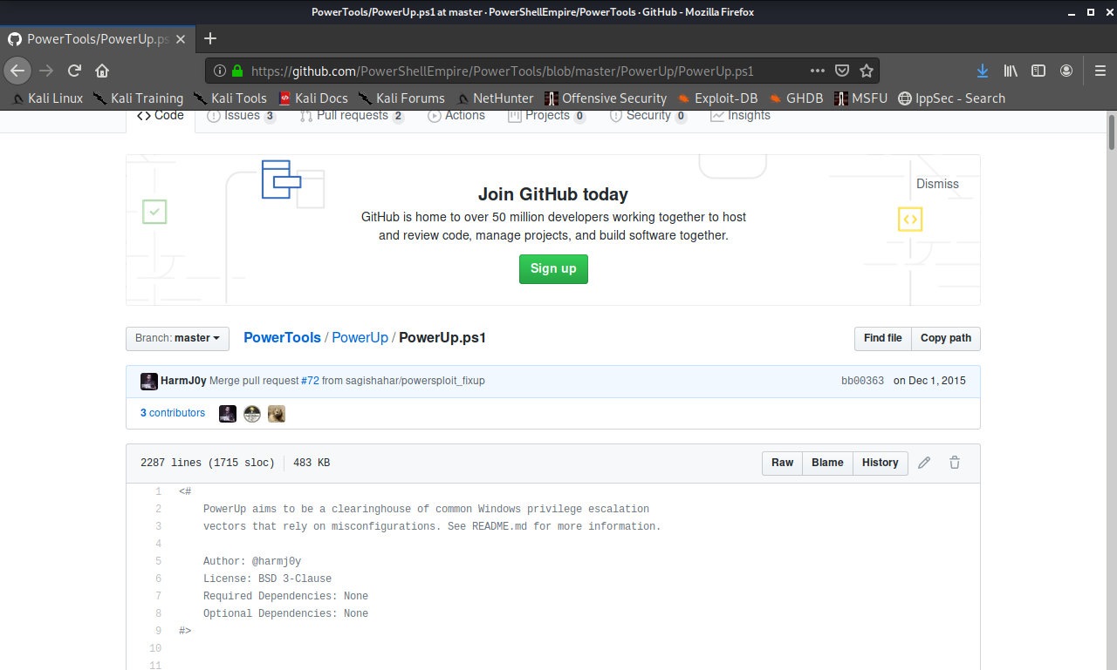

Slide 65
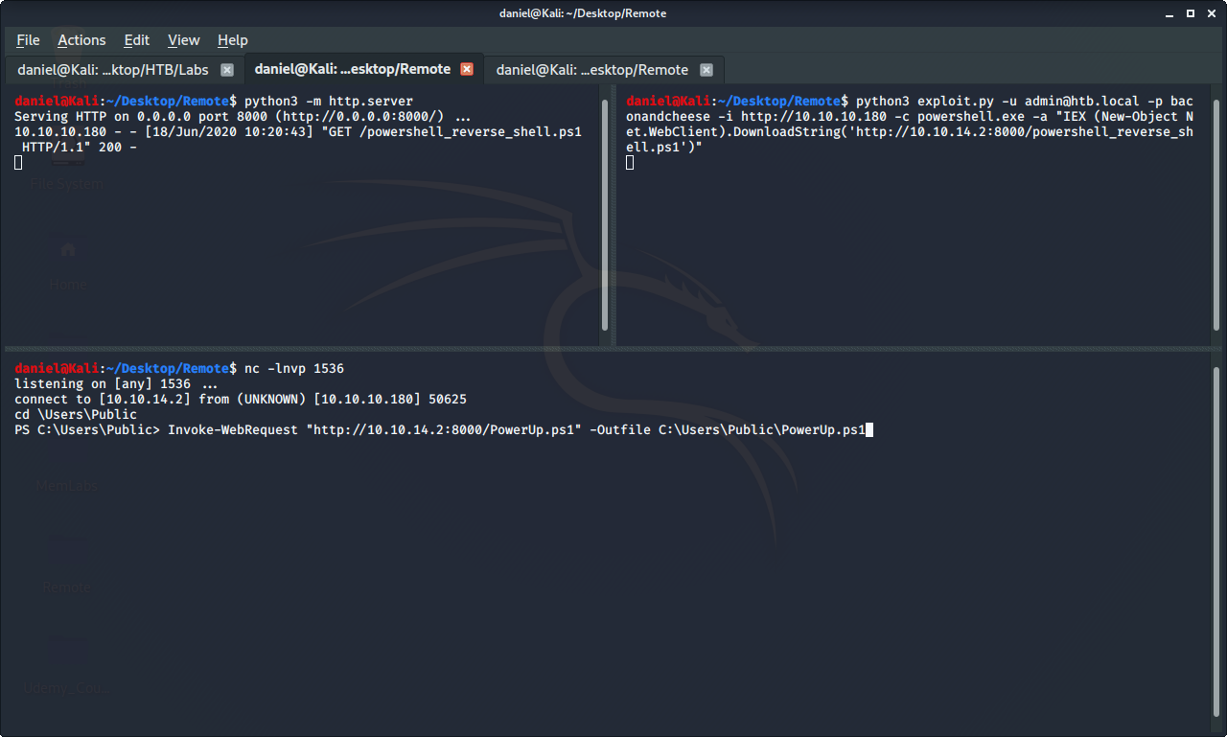

Slide 66
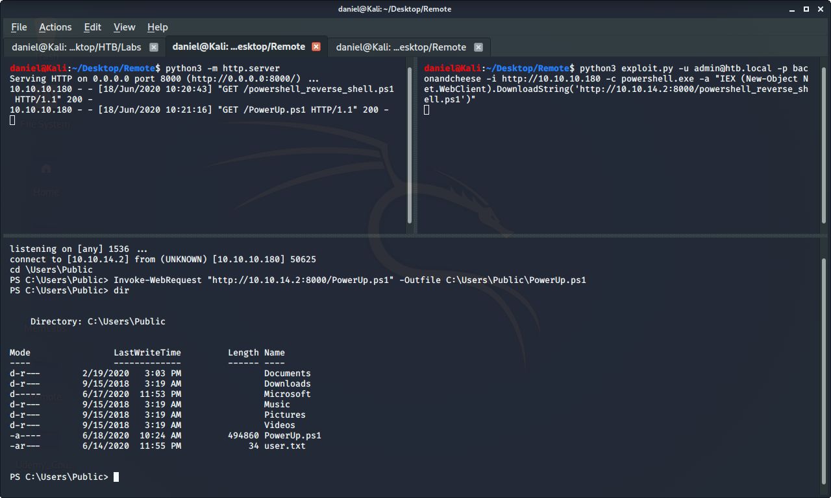

Slide 67
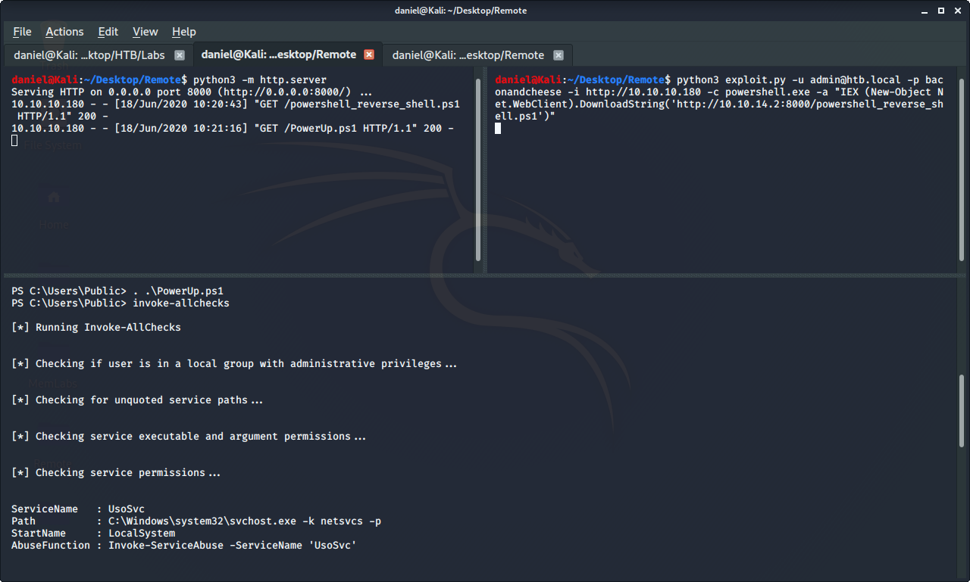

Slide 68
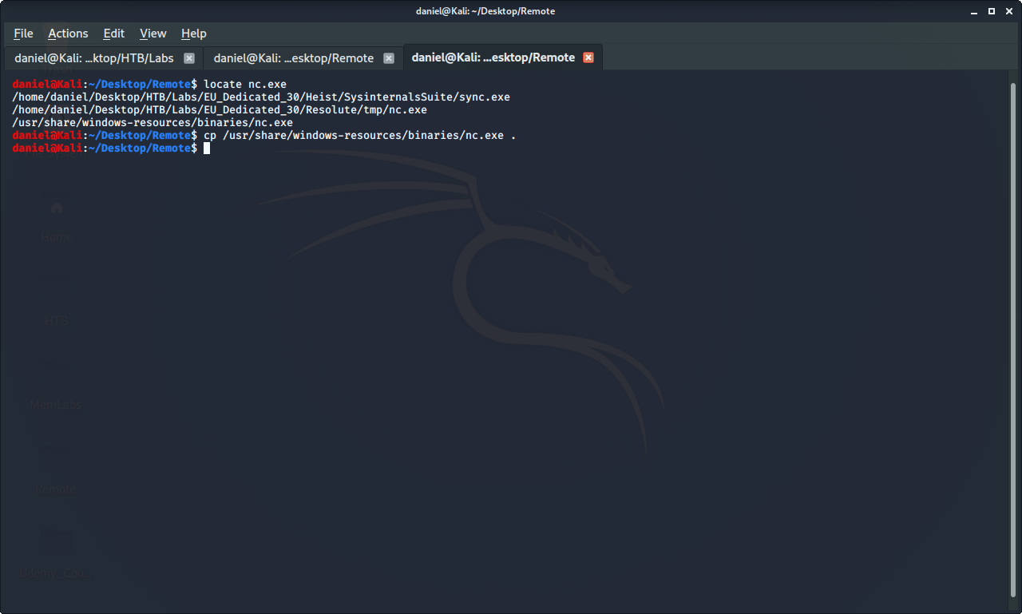

Slide 69
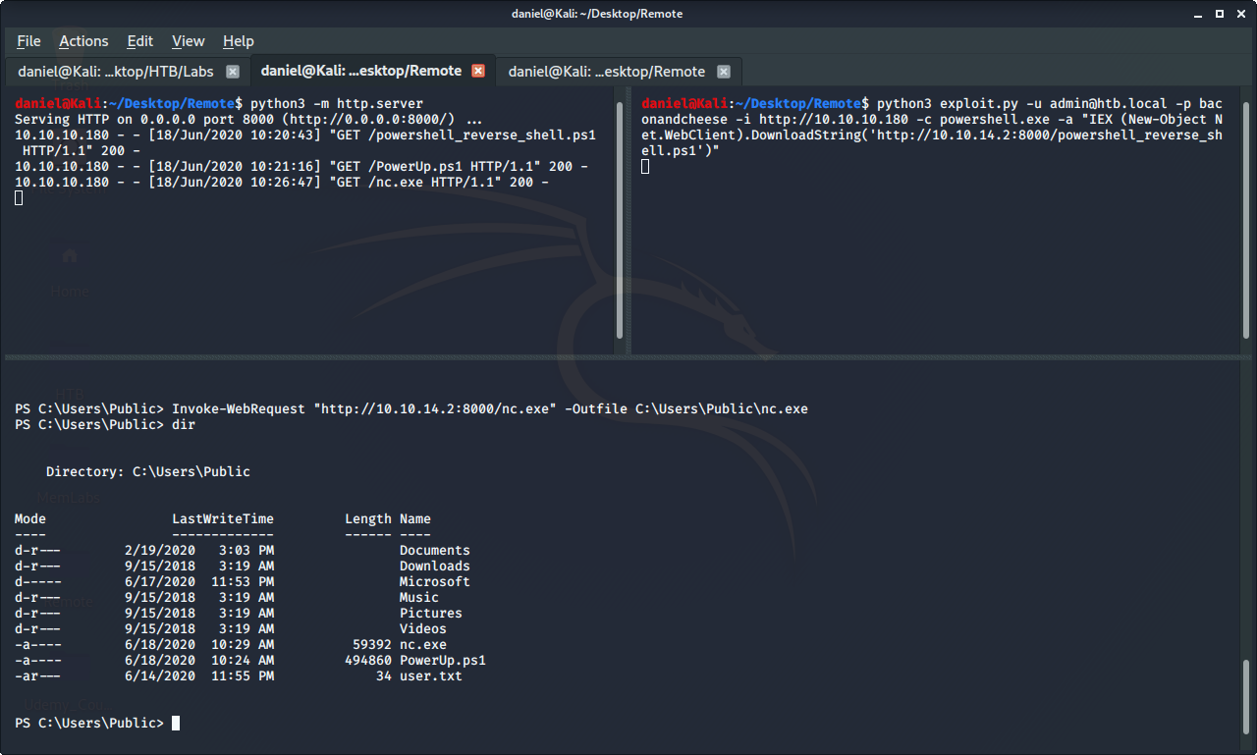

Slide 70
Reverse Shell - Privilege Escalation

Slide 71
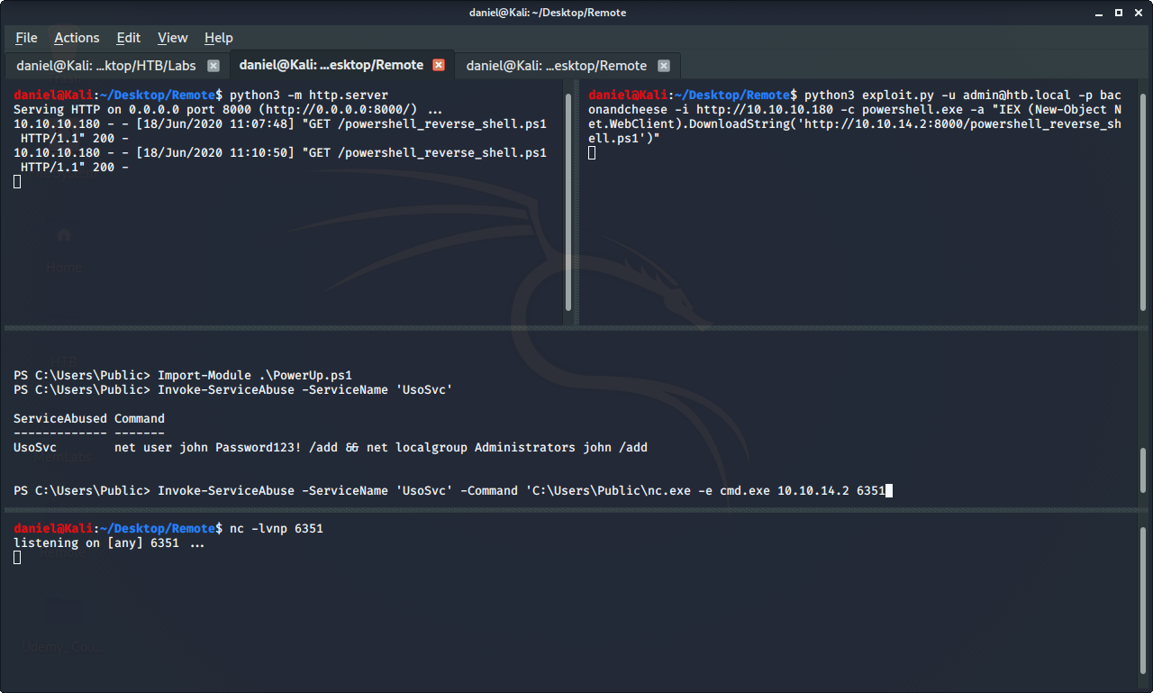

Slide 72
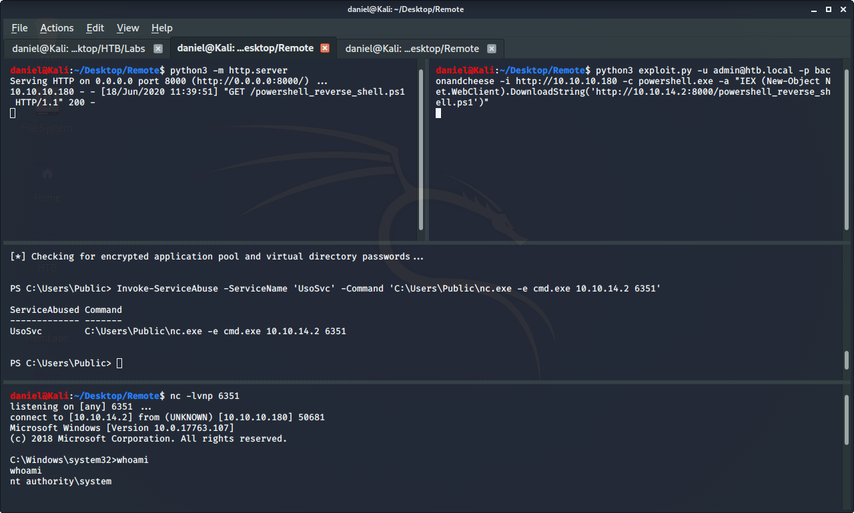

Slide 73
Extra Notes
Additional Exploits:
Metasploit Module for Umbraco RCE
Unattend.xml
What I Learned:
Finding passwords in a haystack
More powershell and Windows files / file structure

Slide 74
Defensive
Using Strong Passwords
Creating NFS shares with passwords
Keeping on Top of Updates

Slide 75
Sources
HTB Lab and Images - https://www.hackthebox.eu
Umbraco Exploit - https://github.com/noraj/Umbraco-RCE
PS Reverseshell - https://gist.github.com/egre55/c058744a4240af6515eb32b2d33fbed3
PowerUp - https://github.com/PowerShellEmpire/PowerTools/blob/master/PowerUp/PowerUp.ps1
Querier - https://medium.com/bugbountywriteup/hackthebox-querier-write-up-1766453dbf76
RE - https://medium.com/@sinfulz/hackthebox-re-walkthrough-2383367a01f4

Slide 76
Questions???

